Slide 1
Chapter 7
Use Cases

Slide 2
Definitions
User-Centered Development
  Based on understanding users needs and the reasons for the system’s development
Use-Case Modeling
  The process of modeling a system’s functions in terms of business events, who initiated the events, and how the system responds
  An approach that facilitates user-centered development

Slide 3
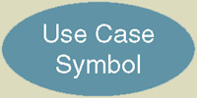
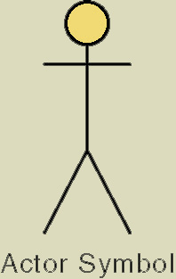
cont’d ...
Use-Case
  A sequence of steps for the purpose of completing a single task
Use-Case Narrative
  Textual description of how the user will interact with the system to accomplish a task
Temporal Event
  An event that is triggered by time

Slide 4
Use Cases
Decompose system functionality
Describe activities to accomplish a single goal
Model functionality of the proposed system
Identify objects and their behavior
Specify what is to be accomplished and why
Define prototypes and user interfaces
Aid in programming and planning testing
Aid in preparing documentation and training

Slide 5
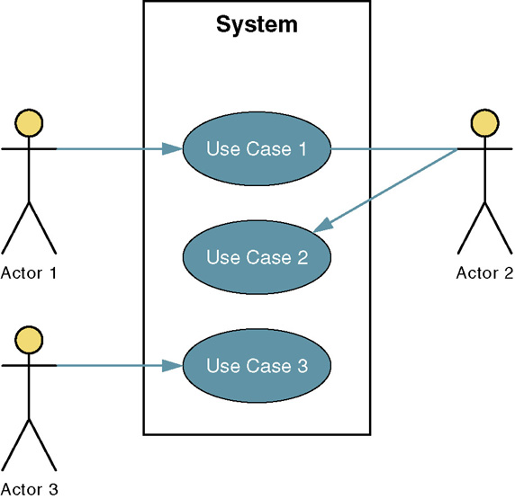
Example Use-Case Diagram

Slide 6
Actors
Anyone or anything that needs to interact with the system to exchange information
Actor Types
  Primary Business Actor (bank customer)
  Primary System Actor (bank clerk)
  External Server Actor (credit bureau)
  External Receiver Actor (warehouse)

Slide 7
Relationships
Associations
Extends
Uses (or Includes)
Depends On
Inheritance

Slide 8
Abstract Use-Case
Reduces redundancy in two or more other use-cases by combining common steps found in both
Available by any other use-case that requires its functionality
Generally not identified in requirements phase
Relationship between abstract use-case and the one that uses it is called a uses or includes relationship

Slide 9
Use-Case Modeling Steps
1. Identify Business Actors
2. Identify Business Requirements Use Cases
3. Construct Use-Case Model Diagram
4. Document Use-Case Narratives

Slide 10
1. Identify Business Actors
Who or what receives output from the system?
Are interfaces required to other systems?
Are there any temporal events?
Who will maintain information in the system?
Who or what provides input to the system?

Slide 11
2. Identify Use Cases
What are the main tasks of the actor?
What information does the actor need?
What information does the actor provide?
Does the actor need to be informed of events?
Does the actor need to inform the system of events?

Slide 12
3. Construct Use-Case Diagram
Graphically depicts the system scope and boundaries
Represent relationship between actors and use cases
Subsystems represent logical functional areas that permit prioritization of use cases

Slide 13
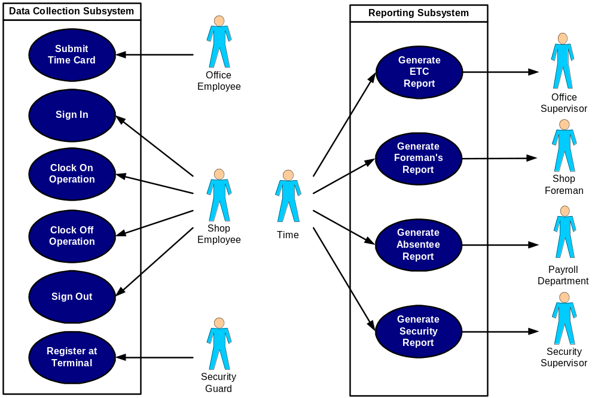
Use-Case Diagram

Slide 14
4. Document Use-Case Narratives
Document narratives at a high level
Expand to a fully documented business requirement narrative
Include exceptions or the conditional branching of the use case

Slide 15
Use-Case Narrative (part 1)
Use-Case Name | CLOCK ON OPERATION
Use-Case-Id | LDS-BUC030.0
Priority | HIGH
Source | LDS-REQ030.0
Primary Actor | Shop Employee
Other Actors | none
Other Interested | Shop Foreman
Stakeholders | Production Control Department
 | Payroll Department
Description | This use case describes the event of a shop employee clocking on to an operation.
 | The employee's status, work order operation, and work center are validated.
Pre-condition | The employee must be active, the work order operation open, and the work center valid
Trigger | The use case is initiated when an employee attempts to clock on to an operation
Typical Course | Actor Action | System Response
of Events | Step 1: The employee scans the barcode | Step 2: The system verifies that the
 | on his badge | Employee Id is active
 | Step 3: The employee scans the work | Step 4: The system verifies that the
 | order operation and work center on the | work order operation is open
 | shop traveler | Step 5: The system verifies that the
 | Step 6: If the work center to be used is | scheduled work center is valid
 | different from the scheduled work center, | Step 7: The system verifies that the
 | the employee enters the new work center | new work center is valid
 | on the touch screen keypad
 | Step 8: The employee touches SEND key | Step 9: The system displays ACCEPTED

Slide 16
Use-Case Narrative (part 2)
Alternate Courses |  | Step 2: The Employee is not active.
 |  | The system displays ERROR
 |  | Step 4: The work order operation is closed.
 |  | The system displays ERROR
 |  | Step 7: The work center is invalid
 |  | The system displays ERROR
Conclusion | The use case concludes when an ACCEPTED message is displayed
Post-condition | The transaction is recorded in the labor database
Business Rules | The employee is an active employee
 | The work order operation is open
 | The work center is valid
Implementation Constraints | GUI provided for shop employee
and Specifications

